Slide 1
FACE EMOTION RECOGNITION USING FACE-API
DOMAIN: ARTIFICIAL INTELLIGENCE
BATCH-A18
DIVYA SRI.G(2018PECCS128)
HUMSIKA.R(2018PECCS138)
KEERTHANA THILAGAM.D(2018PECCS150)
GUIDED BY : Dr. R. JOSEPHINE LEELA

Slide 2
ABSTRACT
Emotion detection research has gained significant attention across different scientific disciplines, including Human-Computer Interaction and Ubiquitous Computing.
Facial Emotion Recognition is a technology which is used to analyze our facial expressions from videos or images in order to reveal information on one's emotional state.
It is the task of classifying the expressions on face images into various categories such as anger, fear, surprise, sadness, disgust, happiness and so on.
We will be implementing Javascript API (face-api.js) introduced by Vincent Mühler for detecting facial emotions on the web.

Slide 3
OVERVIEW
Facial emotion detection is one of the most common applications of Artificial Intelligence. There are many attempts to make an automatic facial expression analysis tools as it has application in many different fields such as robotics, medicine, driving assist systems, and lie detector.
Facial recognition is a way of recognizing or verifying a person’s identity by looking at their face. It identifies people in photos, videos, or real-time using facial recognition systems.
In our project, we will be using face-api.js which is a JavaScript API for face detection and face recognition in the browser implemented on top of the tensorflow.js

Slide 4
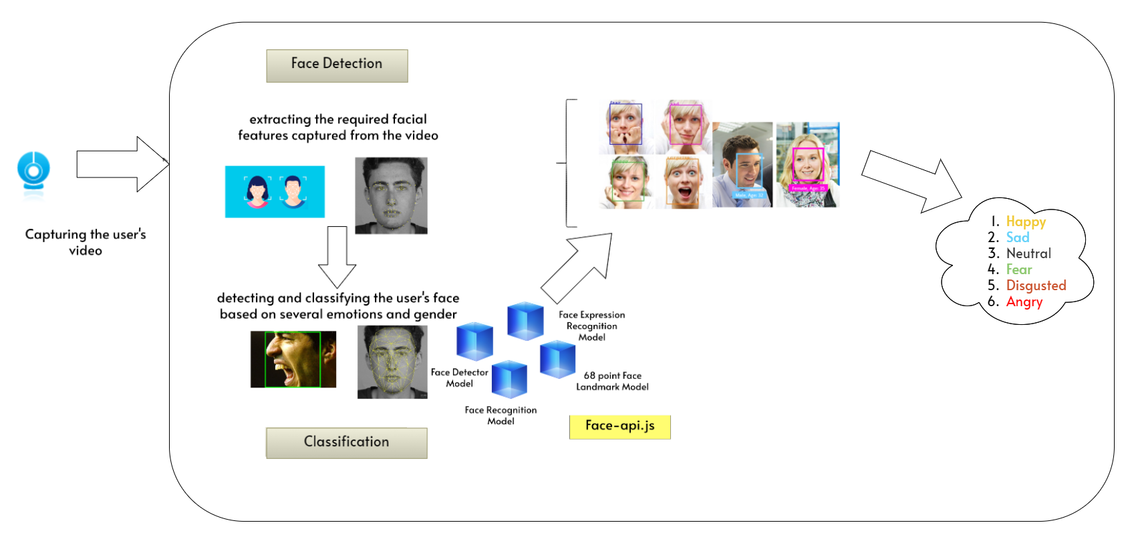
SYSTEM ARCHITECTURE

Slide 5
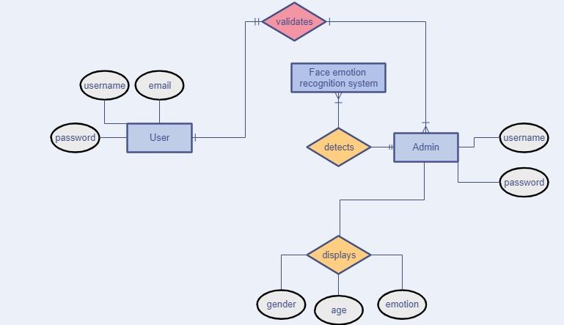
SYSTEM DESIGN
ER DIAGRAM

Slide 6
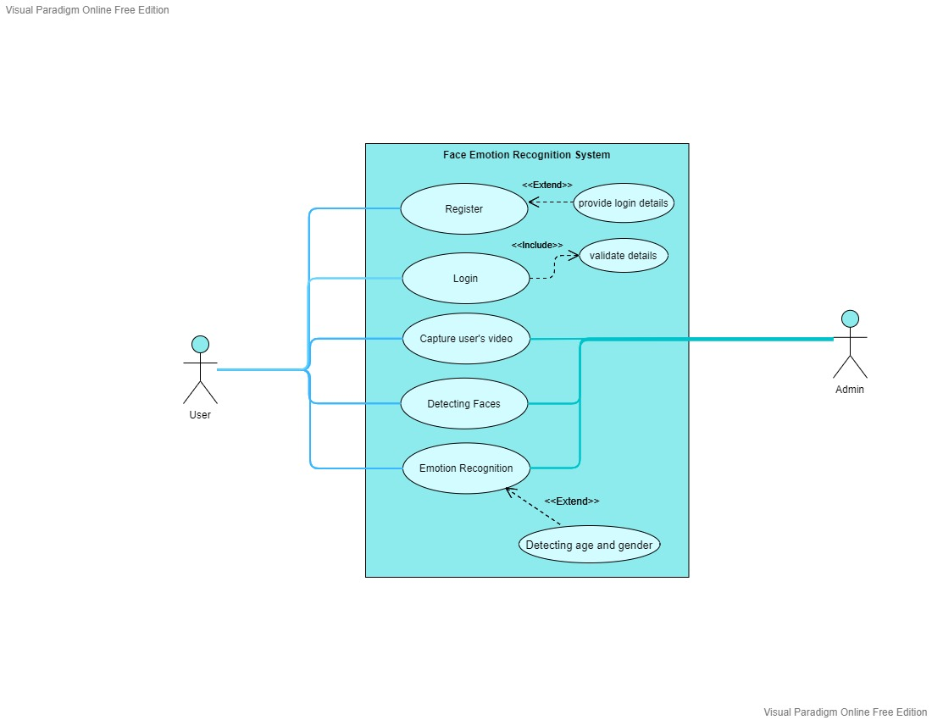
UML DIAGRAMS
USE CASE DIAGRAM

Slide 7
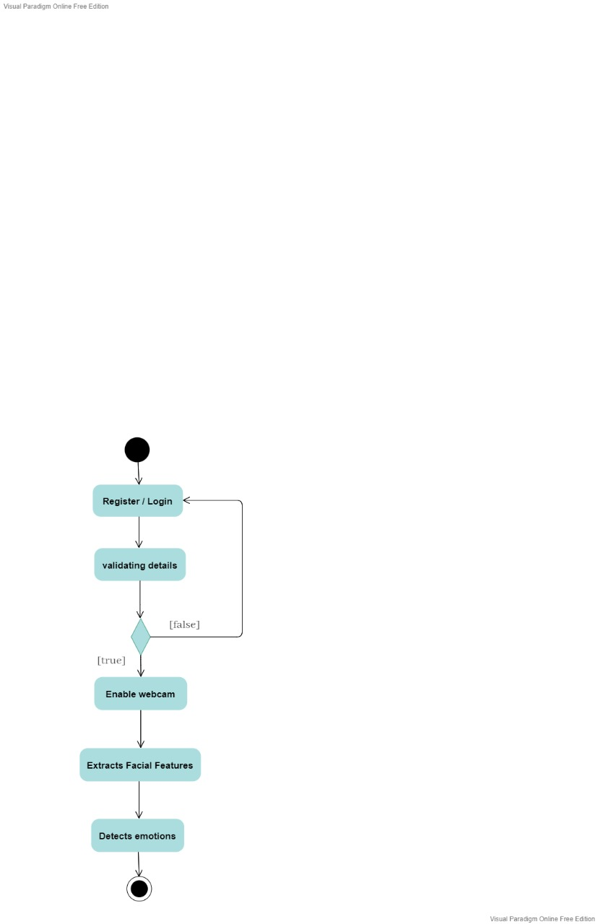
ACTIVITY DIAGRAM

Slide 8
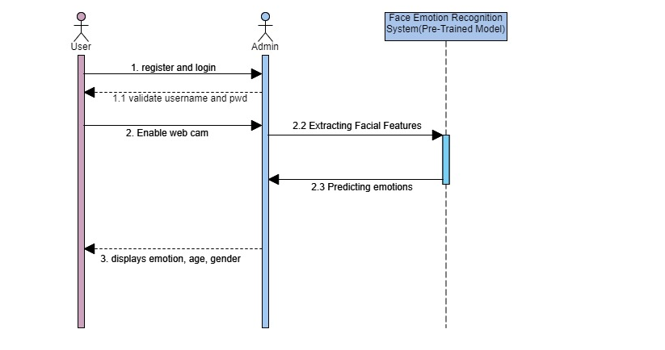
SEQUENCE DIAGRAM

Slide 9
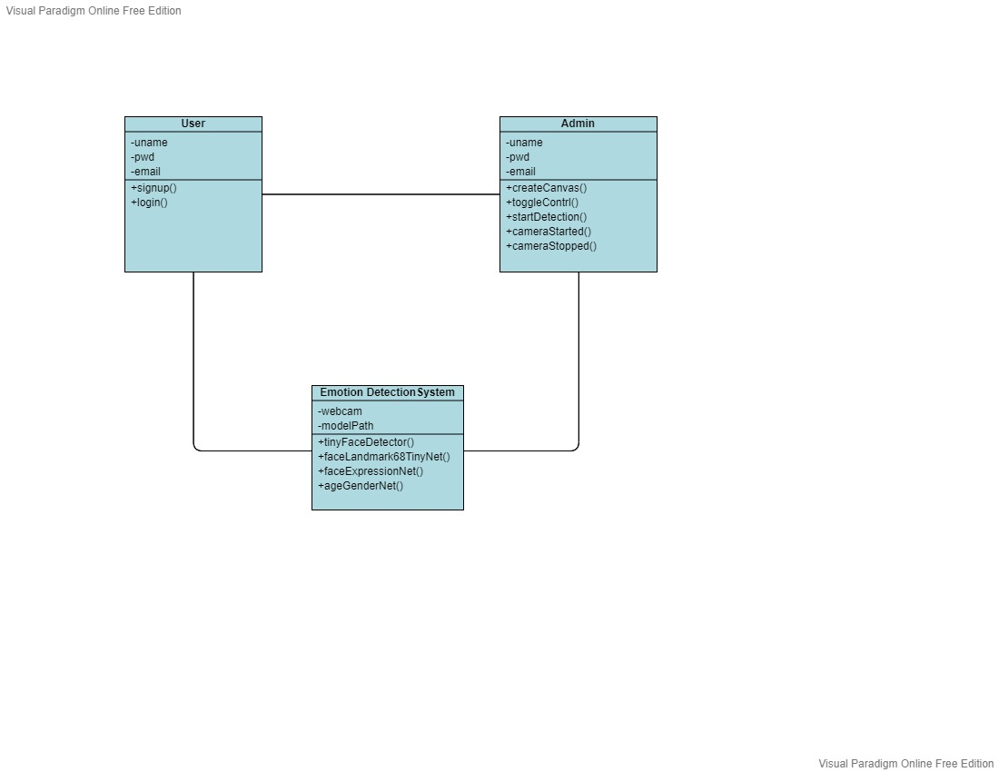
CLASS DIAGRAM

Slide 10
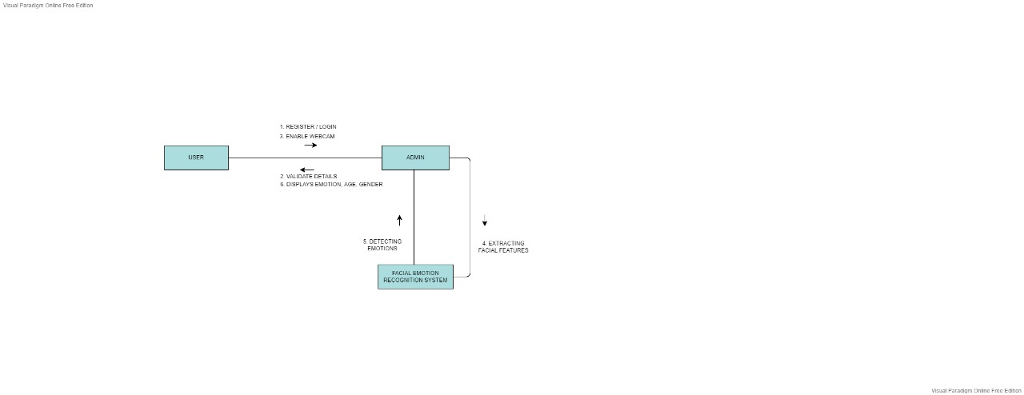
COLLABORATION DIAGRAM

Slide 11
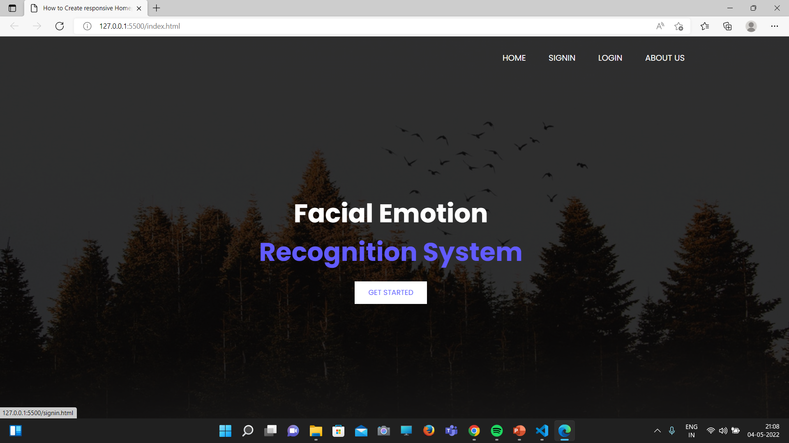
INPUT DESIGN (UI)

Slide 12


Slide 13


Slide 14
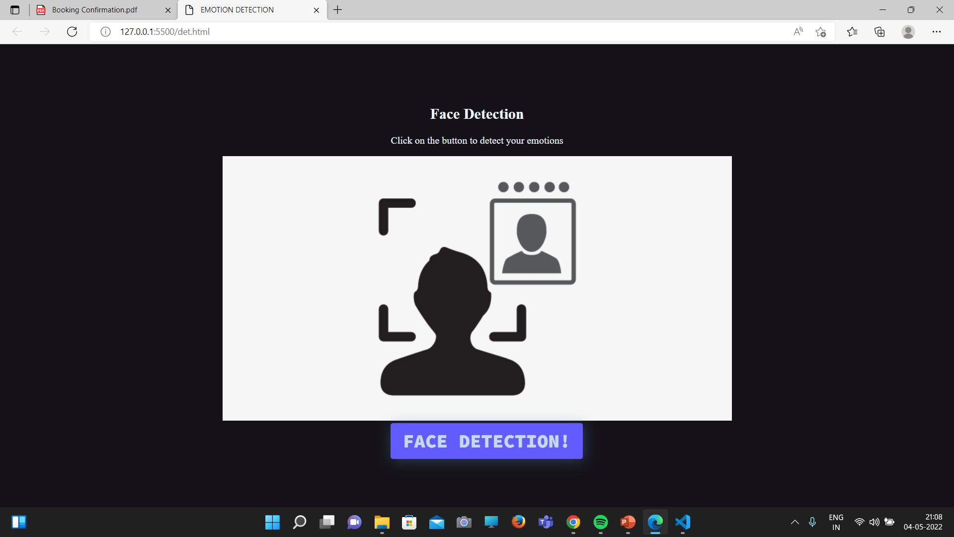

Slide 15


Slide 16


Slide 17


Slide 18
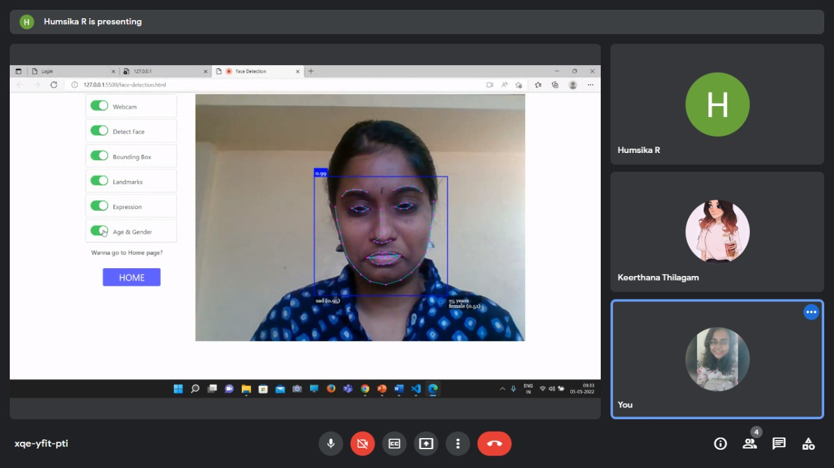

Slide 19


Slide 20
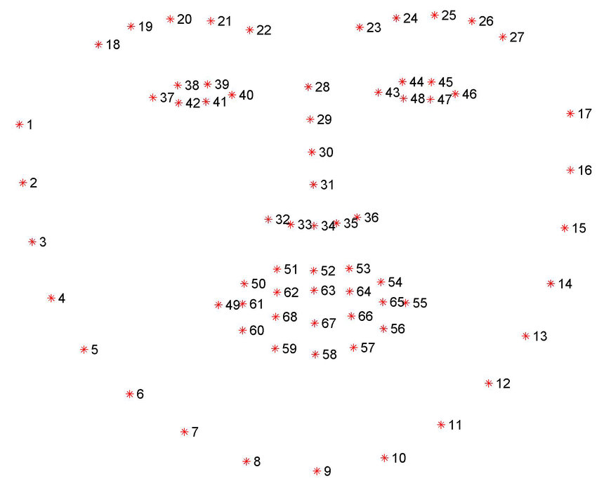
MODULES
Registration:
Here the user can register and login into the system.
User details are validated here.
Face Detection:
With the help of Tiny face detector model the face is detected.
Bounding box appears for the face detected.
Feature extraction:
68 Point Face Landmark model is used to estimate the location of 68 key points on the face.
Emotion Recognition:
Using the Face expression Recognition model , the emotion of the user is detected and displayed along with the age and gender using the Age and Gender Recognition model.

Slide 21
MODEL DESCRIPTION
FACE DETECTION MODEL:
TINY FACE DETECTOR:
The Tiny Face Detector is a very efficient, real-time face detector, the model has been trained to predict bounding boxes that covers the entire facial feature points, resulting in better performance when combined with face landmark detection.
68-POINT FACE LANDMARK DETECTION MODELS:
This model implements a lightweight 68-point face landmark detector with better accuracy at faster rate. This model is used to track and locate the 68 facial points on a person’s face.
FACIAL EXPRESSION RECOGNITION:
Facial expression recognition is the task of classifying the expressions on face images into various categories such as anger, fear, surprise, sadness, happiness and so on.
AGE AND GENDER RECOGNITION MODEL:
Age and gender classification is a dual-task of identifying the age and gender of a person from an image or video.

Slide 22
1. Khadija Lekdioui, Yassine Ruichek, Rochdi Messoussi, Youness Chaabi, Raja Touahni, YEAR: May, 2017 “Facial Expression Recognition Using Face-Regions”, 2017 International Conference on Advanced Technologies for Signal and Image Processing (ATSIP), DOI: 10.1109/ATSIP.2017.8075517 2. Renuka S. Deshmukh and Prof. Vandana Jagtap YEAR: June,2017 “A Survey: Software API and Database for Emotion Recognition”, International Conference on Intelligent Computing and Control Systems (ICICCS), DOI: 10.1109/ICCONS.2017.82507273. 3. Yang-Yen Ou, Bo-Hao Su, Shih-Pang Tseng, Liu-Yi-Cheng Hsu, Jhing-Fa Wang and Ta-Wen Kuan, YEAR: October 2018, “Efficient Emotion Recognition based on Hybrid Emotion Recognition Neural Network”, International Conference on Orange Technologies (ICOT), DOI: 10.1109/ICOT.2018.87059034. 4. D. Ram Kiran, K. Vinay Kumar, T. Kalyan, K. Ch. Kavya, K. Sarat Kumar, YEAR: July 2022, “Facial Expression Detection using Artificial Intelligence”, International Journal of Recent Technology and Engineering (IJRTE), DOI: https://doi.org/10.35940/ijrte.2277-38785. 5. M. Shamim Hossain and Ghulam Muhammad, YEAR: February 2017, “An Emotion Recognition System for Mobile Applications”, Institute of Electrical and Electronics Engineering (IEEE), DOI: 10.1109/ACCESS.2017.2672829
REFERENCES :

Slide 23
THANK YOU !

